Slide 1
Real-Time Threat Detection
-By
Nishit Anand

Slide 2
Problem Statement
Guns and knives are the most common weapon used in committing crimes. Research shows that 79% of all crimes using weapons are done using a gun or a knife
Now days there are CCTV cameras everywhere - in schools, public places, shops, malls etc
Current surveillance systems still require human supervision and intervention.
Our aim is to develop a system that first registers faces of Security Guards, Policemen etc and then detects guns and knives in video footage and notifies the authorities if it detects guns or knives with an unregistered person. This may be a threat. So it sends notification to the concerned authorities.

Slide 3
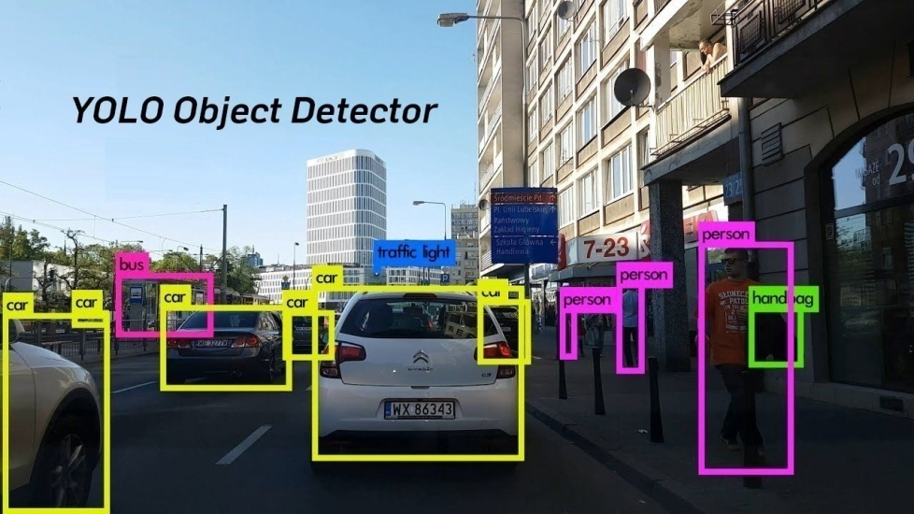
State-of-the-Art and their limitations
There are many object detection models such as R-CNN, Faster R-CNN, YOLO etc which are State-of-the-Art
Models such as R-CNN first generate potential bounding boxes in an image and then run a classifier on these proposed boxes. Even though they are accurate, due to their complex pipelines, they are very slow and hard to train. Also they are very slow for detection which makes them unfit for real time object detection

Slide 4
Models such as YOLO see object detection as a single regression problem. This makes it extremely fast. YOLOv4 achieves mAP of 43.5% on MS COCO dataset at 65FPS on Nvidia V100 GPU.
It is very accurate also, achieving twice the Mean Average Precision of other object detection systems.
But it has weights of MS COCO dataset which doesn’t contain the classes of Gun and Knife and we trained it on custom images of faces of people. For our model we trained it on images of my sister and mother.
So we decided to train YOLOv4 on our dataset of guns and knives and images of faces and then tested it on various video clips to see how well it detects guns and knives and registered people

Slide 5
Objectives and Work Distribution
Objectives-
To develop a system that detects guns and knives in video footage along with faces of registered people
It then notifies the authorities in charge as soon as it detects guns or knives with an unregistered person who may be a thief or a terrorist so that timely action can be taken
Work Distribution-
Nishit Anand – Collecting Data, Configuring the obj.data, obj.names and yolov4-obj.cfg files, Writing the Jupyter Notebook, Training the Dataset, Testing it on various photos and videos and finding the best weights file and best threshold value, wrote code to collect facial data from images, converted coordinates of face from normal to YOLOv4 format
Samriddhi Srivastava – Testing the model
Jai Shiv Kalra – Testing the model

Slide 6
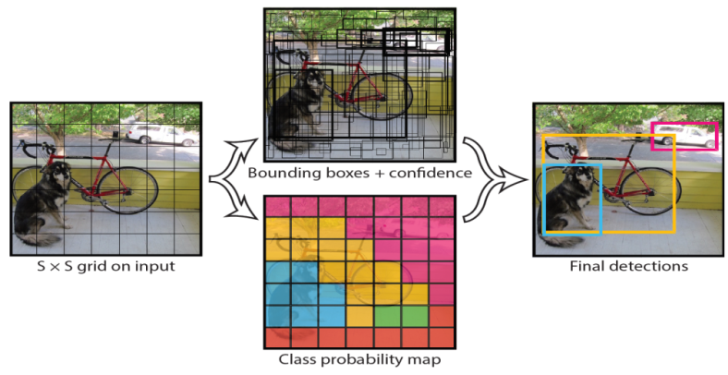
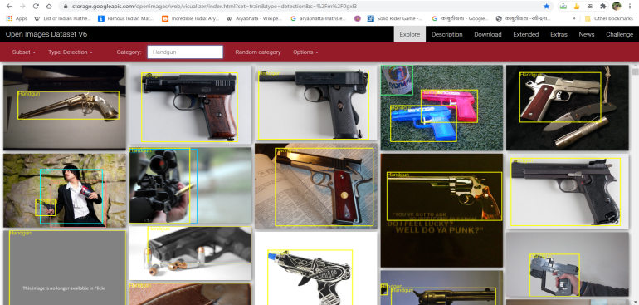
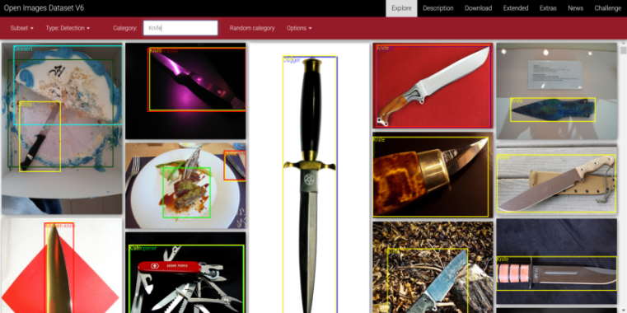
Proposed Design and Implementation
YOLO divides the input image into an S × S grid. Each grid cell predicts B bounding boxes and confidence scores for those boxes. These confidence scores reflect how confident the model is that the box contains an object and also how accurate it thinks the box is that it predicts
Steps - We downloaded images of guns and knives and their labels from Google Open Images Dataset v6

Slide 7
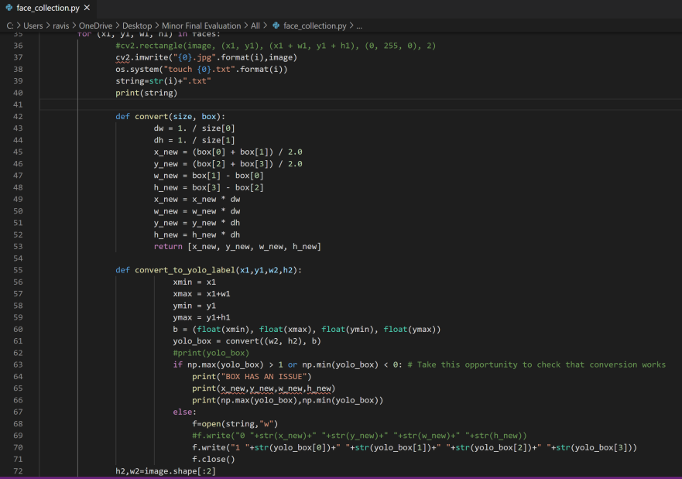
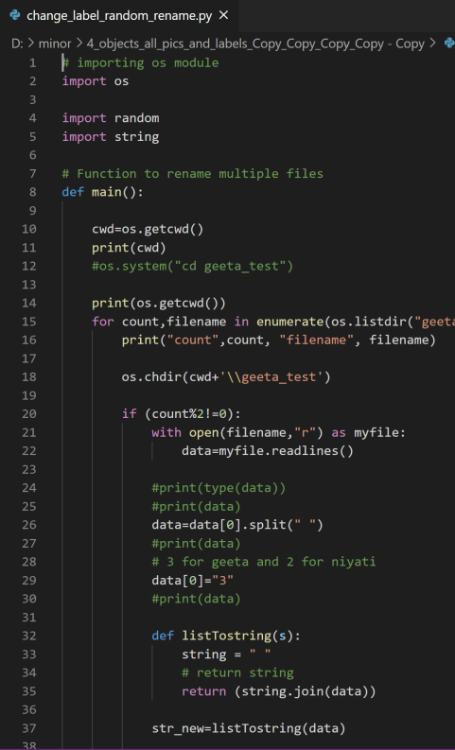
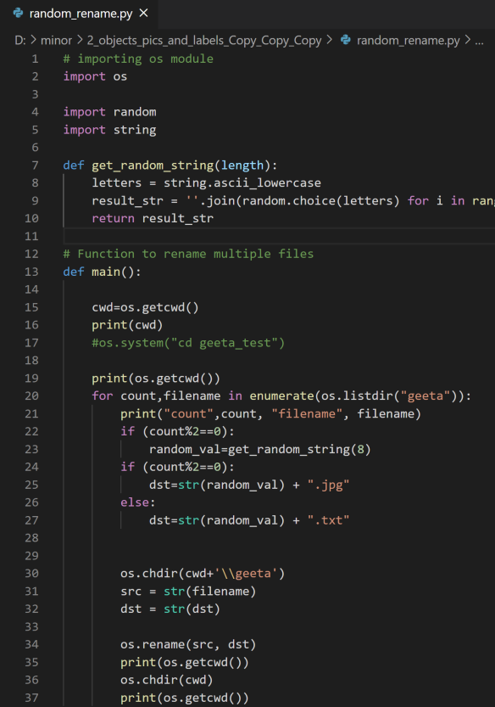
For collecting images of people’s face for training the model, we wrote a python program which saves images as a .jpg file and coordinates of the person’s face in that image as a .txt file.
This program also converts these labels (.txt files) to YOLOv4 format, so that we can use them for training.
Then another program renames all 14,000 files to random name instead of the earlier numbered name so that the model can learn better and not just one person’s face at a time and this gives better results.
Then a program labels all these files as the numbre given to their corresponding names in obj.names file
Then these images and their labels are sent for training the model

Slide 8
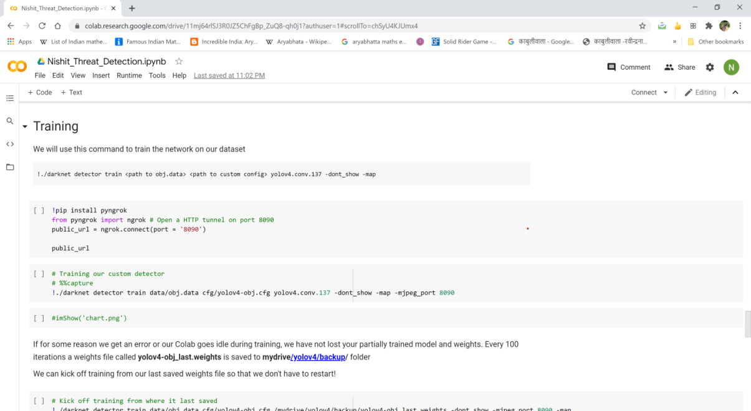
Then we configured the obj.names file and obj.data file and yolov4-obj.cfg file and uploaded them to Google Drive along with the test and train images and their labels
Then we trained the model using our dataset on Google Colab for 10,000 iterations. After Every 100 iterations and 1000 iterations weights files were saved in the Google Drive
Then we tested mAP and Average IOU of these weights to find which one was the best. It was found to be 9600th iteration.
This weights file was then used for detection. We varied height, weight and threshold value to find which combination gave best results.

Slide 9
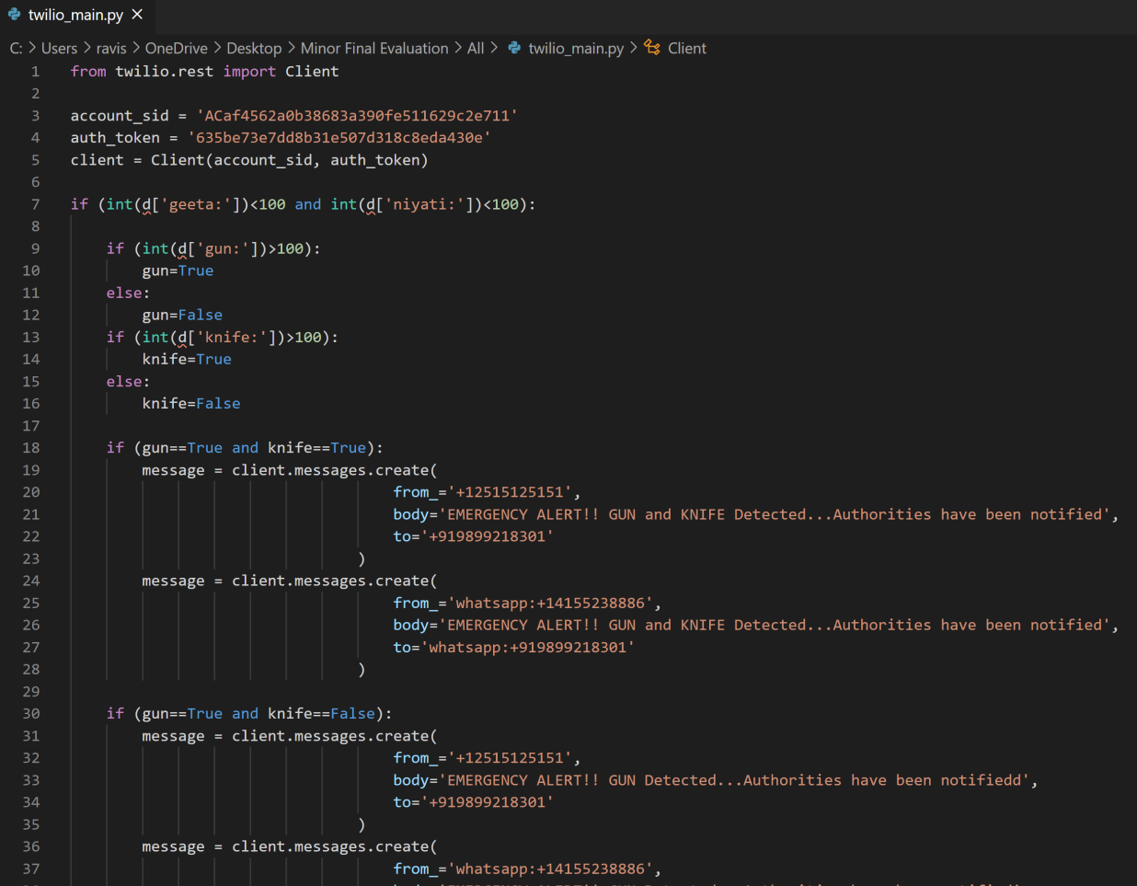
Using Twilio to send SMS and Whatsapp message to the concerned authorities -
We have used Twilio API to send SMS and Whatsapp message. If any registered face is detected along with Gun or Knife for more than 100 times i.e. 4 seconds (as video is 24 frames per second), then it means that it is safe, so an SMS and a Whatsapp notification is not sent to the authorities. But if a registered person is not detected and the number of times a Gun or Knife is detected is more than 100 times, then message “Emergency Alert!! GUN and KNIFE Detected…Authorities Notified” is sent. Since videos are 24frames per second. So if a gun or knife is detected for 4 seconds or more, then the authorities are notified.

Slide 10
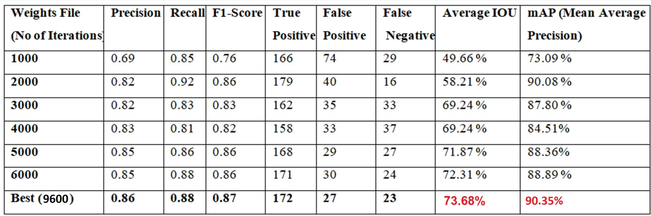
Results and Analysis
We tested the Average IOU and mAP of different weights files saved during training to find which one was the best. The highest Average IOU was achieved in 9600th iteration weight file and was 73.68% and highest mAP was 90.35%, so we have used that weight file for all detections and it provided the best results out of all.

Slide 11
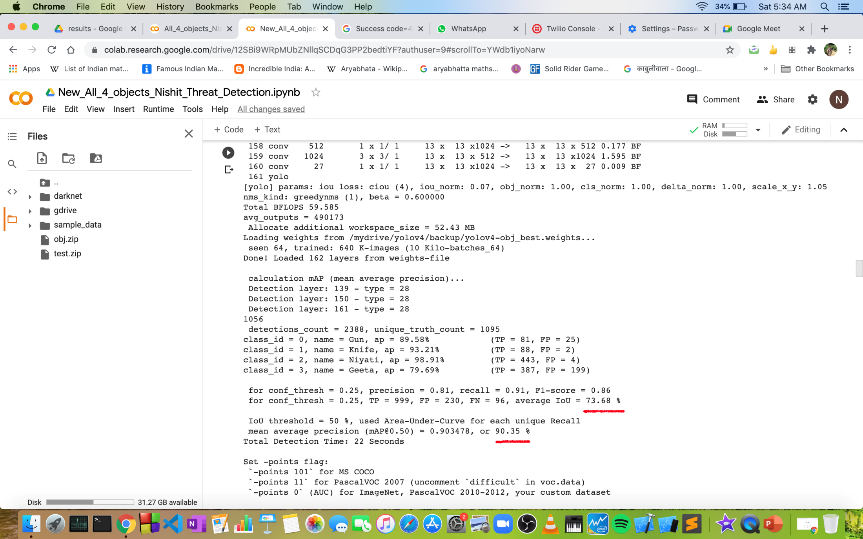
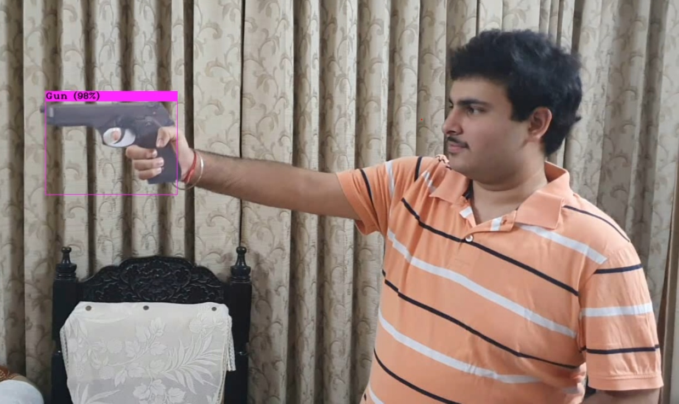
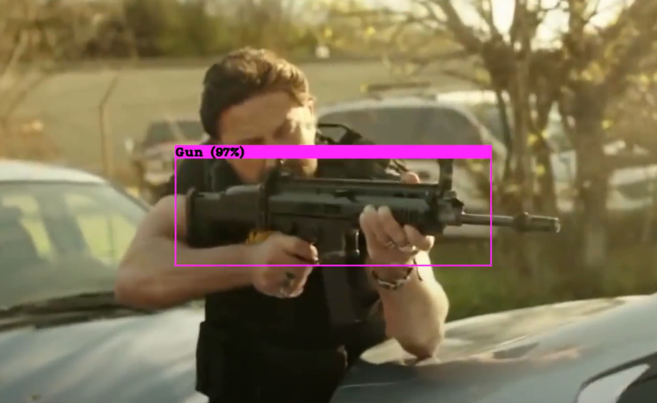
Some of our Results-
Highest mAP and HighestAverage IOU
Gun Detection

Slide 12
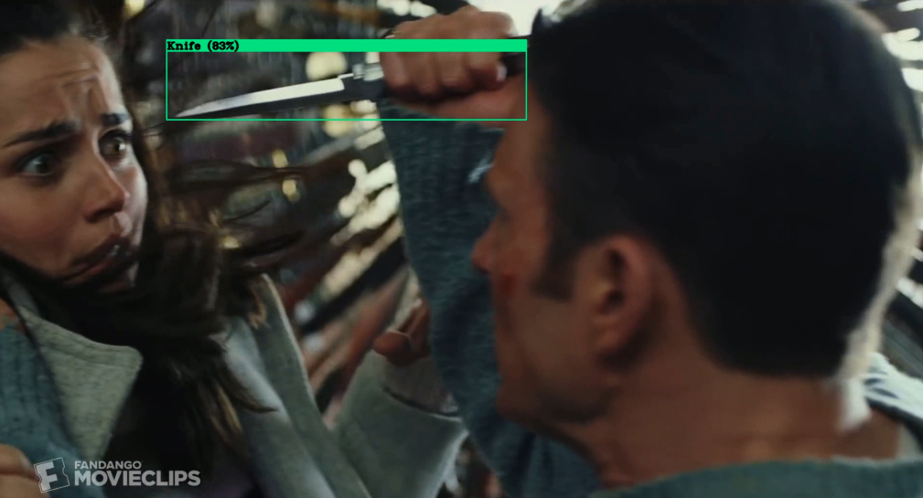
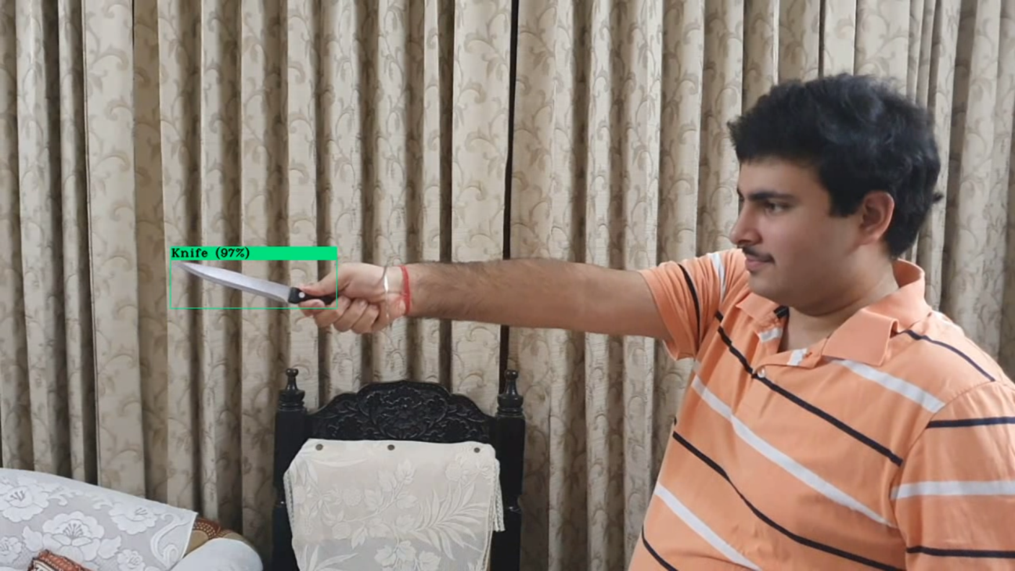
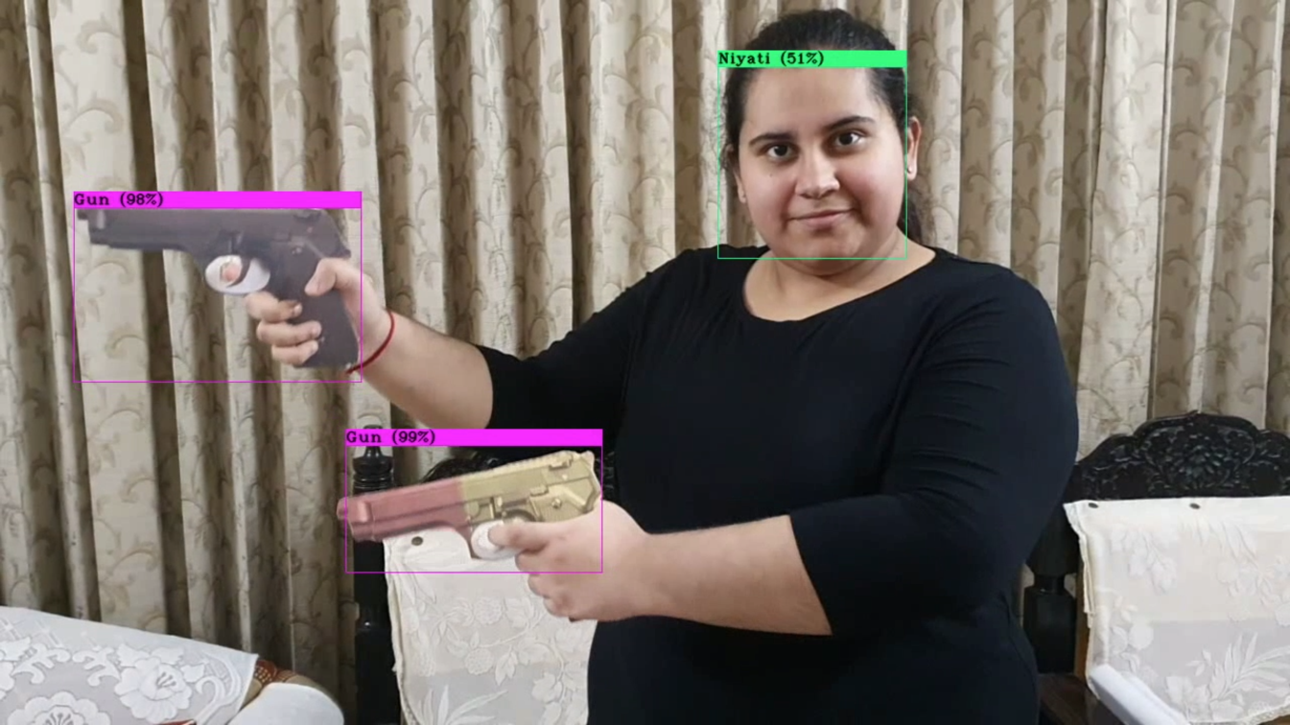
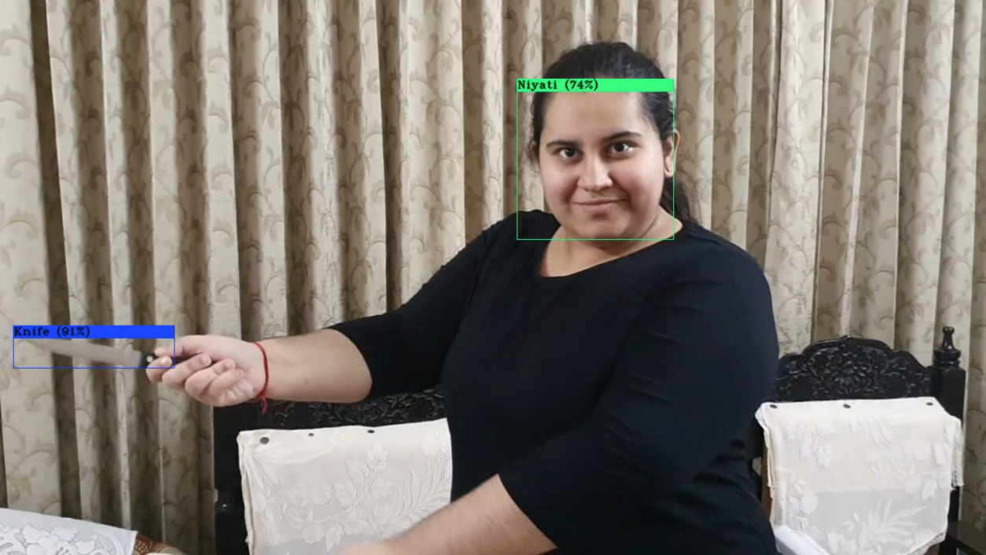
Knife Detection
Gun and Knife Detection along with Registered Faces

Slide 13
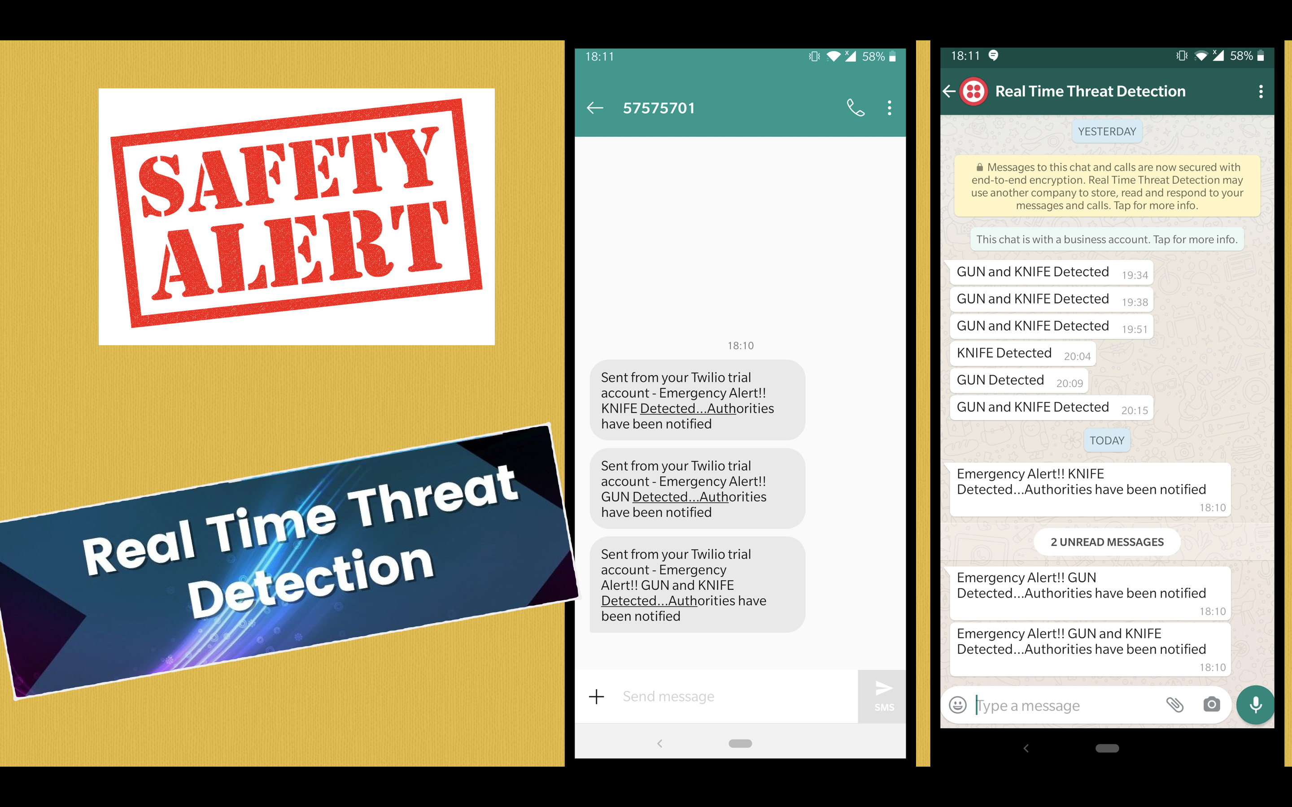
SMS Alert Recieved
WhatsApp Alert Recieved

Slide 14
Conclusion of the Report
Now after training the YOLO neural network on 7,100 images for many hours and testing it on a variety of photos and video clips, we have found that we get the best accuracy with 9600th iteration weights file. It is able to successfully find and draw bounding boxes for guns and knives. It is also able to successfully detect face of registered persons along with them. It is able to generalize and recognize them even if they are in fast moving videos or are small in size.
We tried different tests on video clips by varying the height and width. We set width and height to (416,416) and to (608,608) and to (832,832). We observed that the best results were achieved when height and width were (416,416). And also Average FPS (Speed) was fastest for this height and weight.
We tried changing different parameters to see which one yielded best results. We used Twilio to send SMS and Whatsapp.

Slide 15
Future Scope
The alerts are generated for guns and knives as of now and can be further taken forward to identify other threats such as people whose behavior seems suspicious under the camera footage i.e. actions such as robbing, any kind of assault, threatening etc.
In many future applications, it would be interesting to detect objects that are usually considered as background. The detection of such “background objects”, such as number plates, apparels which have something written on them can be useful for identification purposes.

